Slide 1

Software Engineering (CS3201) Software Requirements
Avinash

Slide 2

Introduction
The Requirements for a system are the descriptions of the services that a system should provide and the constraints on its operation
Requirements reflect the needs of customers
The process of finding out, analyzing, documenting and checking (the feasibility) of these services and constraints is called requirements engineering (RE)
The term 'requirement' is not used consistently in the industry
Sometimes, it is a high-level, abstract statement of service
Other times, it can be a detailed and formal definition of a system function
Both these types of requirement specification may be the 'Requirements document' for a system
These two types of requirements are distinguished using the terms user requirements and system requirements
Notes:
1. Novelty
Many software projects involve new, untested ideas or emerging technologies.
Developers may lack prior experience or best practices to follow.
Unforeseen technical challenges and risks arise when working with novel concepts.
2. Changing Requirements
Stakeholders often refine or alter their needs as the project progresses.
Changes can introduce inconsistencies, requiring rework and delaying progress.
Agile methodologies help adapt to changes, but they still add complexity.
3. 5x Cost During Development
Fixing defects, refactoring code, and modifying features are costly in later development stages.
Issues not caught in design or early coding phases require significantly more effort to correct.
Testing, debugging, and integrations demand additional resources.
4. Up to 100x Cost During Maintenance
Bugs found after release require more effort to diagnose and fix in a live environment.
Legacy systems become harder to maintain as technology evolves and documentation decays.
Security updates, performance optimizations, and feature enhancements increase costs.
5. Hardware/Software Configuration
Software must run on various hardware setups, operating systems, and third-party dependencies.
Compatibility issues arise, requiring extra testing and development effort.
Performance tuning depends on hardware capabilities, adding to complexity.
6. Security Requirements
Applications need protection against hacking, data breaches, and malware.
Secure coding practices, encryption, and compliance with regulations (e.g., GDPR, HIPAA) add development overhead.
Security vulnerabilities can lead to severe financial and reputational damage.
7. Real-Time Requirements
Some systems (e.g., autonomous vehicles, stock trading platforms) require immediate processing.
Optimizing for low-latency, deterministic execution adds technical challenges.
Failure to meet real-time constraints can cause catastrophic consequences.
8. Reliability Requirements
Critical systems (e.g., healthcare, aviation) must function with minimal downtime.
High availability, fault tolerance, and disaster recovery planning are required.
Rigorous testing (e.g., stress testing, failover simulations) increases development complexity.

Slide 3
User Requirements and System Requirements
User Requirements
User requirements are statements, in a natural language plus diagrams, of what services the system is expected to provide to system users and the constraints (under which it should operate)
System Requirements
System requirements are more detailed descriptions of the software system’s functions, services, and operational constraints. The system requirements document (sometimes called a functional specification) should define exactly what is to be implemented
Different kind of requirements are needed for different kinds of readers (Customers and managers speak one language, dev other)

Slide 4
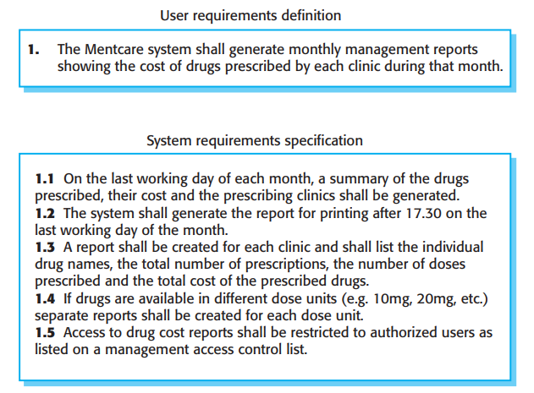
Example: User and System Requirements

Slide 5
Example 2: User and System requirements (Sustainable shopping app)
User Requirements
1. Barcode Scanning: The user should be able to scan a product barcode and see its sustainability rating.
2. Sustainability Information: The user should be able to see environmental impact details of a product (carbon footprint, recyclability, ethical sourcing).
3. Eco-Friendly Alternatives: The app should suggest more sustainable alternatives for scanned products.
4. Bill Analysis: The user should be able to upload or scan a supermarket bill and get an ecological footprint summary.
5. Personal Impact Tracking: The user should be able to track their sustainability score over time.
System Requirements
Barcode Scanning:
SR1.1: The system shall allow users to scan EAN-13 and UPC-A barcodes using the mobile device camera.
SR1.2: The system shall retrieve product data from the sustainability database within 3 seconds of a successful scan.
SR1.3: If the barcode is not found, the system shall display “Product not available in database.”
Sustainability information:
SR2.1: The system shall display:
Carbon footprint (kg CO₂ equivalent per unit)
Packaging recyclability percentage
Ethical sourcing score (1–10 scale)
SR2.2: The system shall show a sustainability rating on a 0–100 scale.

Slide 6
System stakeholders
The different types of document readers (managers, clients, developers, etc.) are examples of system stakeholders
System stakeholders include anyone who is affected by the system in some way and so anyone who has a legitimate interest in it or is impacted by it

Slide 7
Example: Stakeholders for Mentcare
Patients whose information is recorded and relatives of these patients
Doctors who are responsible for assessing and treating patients
Nurses who coordinate the consultations with doctors and administer some treatments
Medical receptionists who manage patients’ appointments
IT staff who are responsible for installing and maintaining the system
A medical ethics manager who must ensure that the system meets current ethical guidelines for patient care (confidentiality, informed consent, etc.)
Health care managers who obtain management information from the system
Medical records staff who are responsible for ensuring that system information can be maintained and preserved, and that record keeping procedures have been properly implemented

Slide 8
Example: Stakeholders for Sustainable Shopping App
End users/ app users who install and use the app (primary stakeholders)
Supermarkets who integrate their catalog with the app
Sustainability data providers who provide sustainable ratings data
App owners/ Product team who designed the app
Technology providers who provide third party bar code scanning API
Advertisers & partners who showcase their sustainable products using our app
Society and environment who are benefited by people using the app (these are the indirect stakeholders)

Slide 9
Requirements Engineering
Requirements engineering is usually presented as the first stage of the software engineering process
Before committing to system development, a preliminary understanding of requirements is needed to form a high-level view of system functionality and benefits, enabling informed decision-making about feasibility and investment.
These may then be considered in a feasibility study, which tries to assess whether or not the system is technically and financially feasible
Help decide whether to procure or develop (or drop) the system

Slide 10
Requirements Engineering - breakdown
Understand the Needs → Talk to users & stakeholders to know what they want
Define Requirements → Clearly describe what the system should do
Check Feasibility → Ask whether requirements are realistic & achievable?
Document Everything → Write down the requirements in a structured way
Manage Changes → Update requirements if needs change during development (even waterfall allows change, but change is controlled, expensive, formal and time consuming)

Slide 11
Feasibility Studies
"A feasibility study is a short, focused study that should take place early in the RE process. It should answer three key questions: (1) Does the system contribute to the overall objectives of the organization? (2) Can the system be implemented within schedule and budget using current technology? and (3) Can the system be integrated with other systems that are used? If the answer to any of these questions is no, you should probably not go ahead with the project."
Sommerville (Software Engineering, web sections) - feasibility study

Slide 12
Functional and Non-functional Requirements

Slide 13
Introduction
Software system requirements are often classified as functional or non-functional requirements
Functional Requirements: These are statements of services the system should provide, how the system should react to particular inputs, and how the system should behave in particular situations. In some cases, the functional requirements may also explicitly state what the system should not do
Non-functional Requirements: These are constraints on the services or functions offered by the system. They include timing constraints, constraints on the development process, and constraints imposed by standards. Non-functional requirements often apply to the system as a whole rather than individual system features or services

